Slide 1
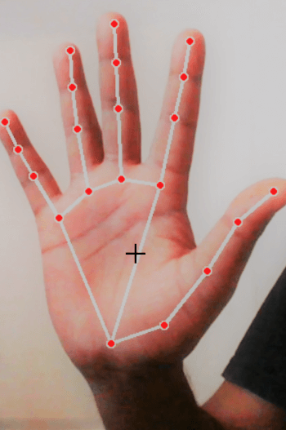
HAND GESTURE RECOGNITION IN MEDICAL APPLICATION
USING ARTIFICIAL INTELLIGENCE
ENJKJSHI
PRESENTER: GUIDE:
HANEESH-2010030323 Dr. Arpita Gupta
LAHARI -2010030372 MAM
MOUNIKA -2010030384
RITHVIK -2010030421

Slide 2
INDEX
1
2
3
4
TOPIC-1
TOPIC-2
TOPIC-3
TOPIC-4
PROJECT AREA
LITERATURE SURVEY.
CONCLUSION.
SUGGESTIONS.

Slide 3
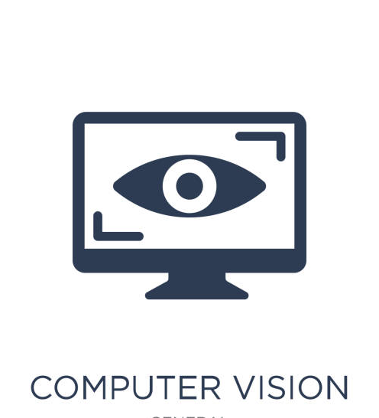
ABSTRACT:
Our project domain is COMPUTER VISION
and sub-domain is GESTURE RECOGNITION.
Computer vision is the study in which it deals with the computers and systems which understand or takes data through images, videos, or any other visual inputs.
It acts as a human visual system and can carry on tasks we specify.

Slide 4

GESTURE RECOGNITION:
Gesture recognition is a means of human-machine interaction using only body actions without the aid of voice.
The concept of recognizing gestures using hands and/or other body parts is based on three layers: Detection, Tracking and Recognition. We use special interfaces that can capture these movements, and later use computer vision technology & deep learning algorithms to understand the underlying pattern.

Slide 5
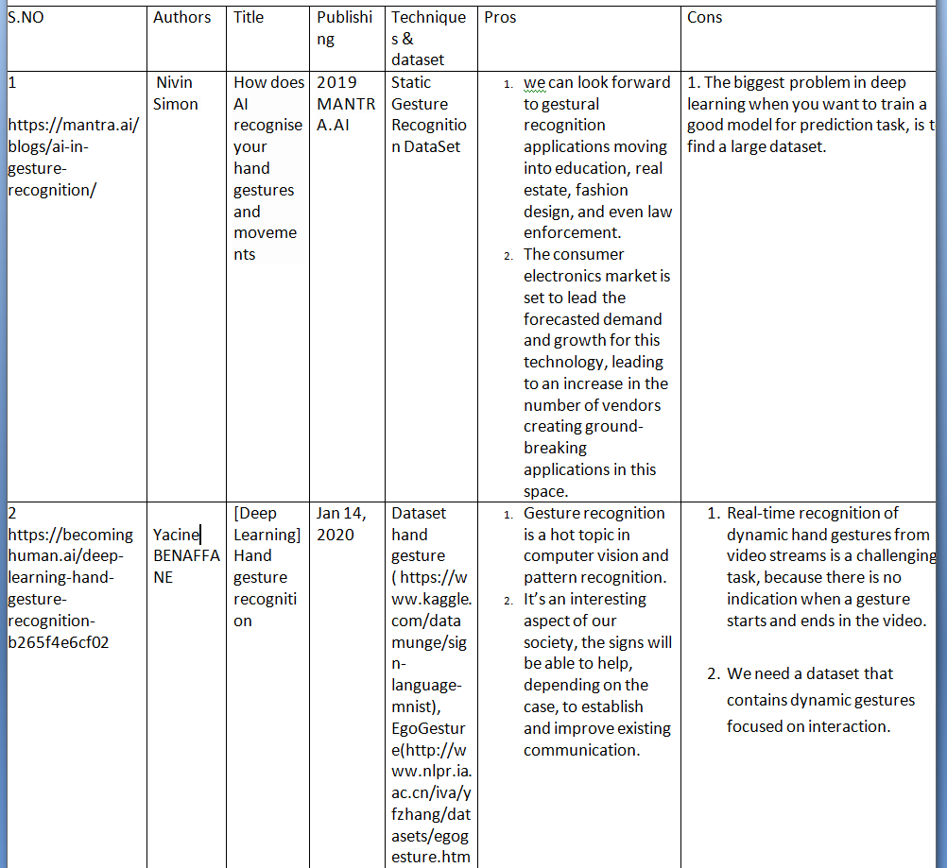
LITERATURE SURVEY

Slide 6
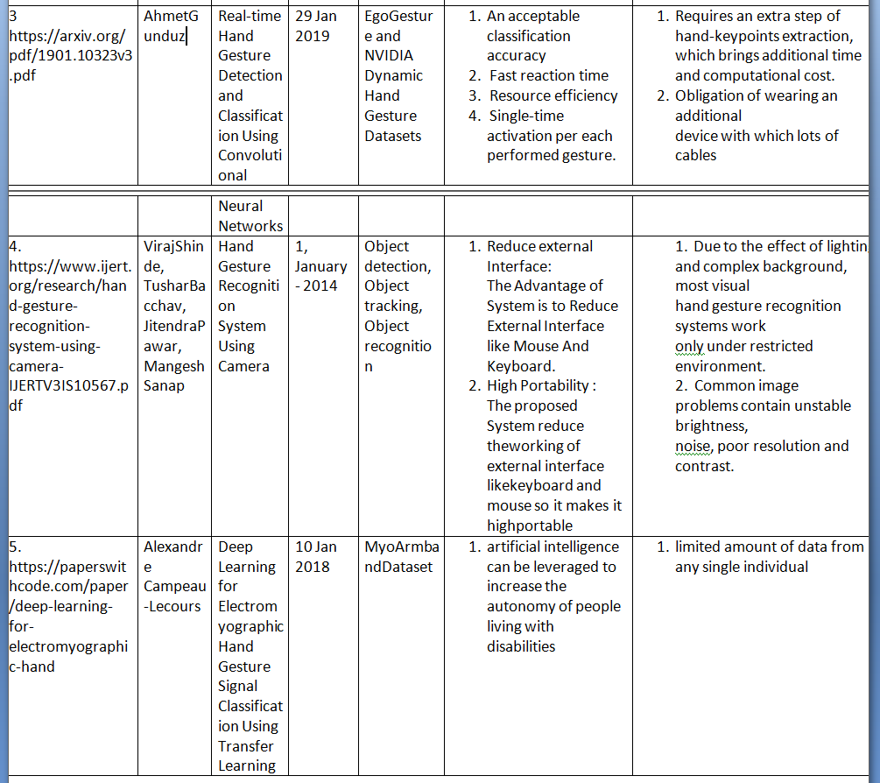

Slide 7
During the coronavirus pandemic, people are reluctant to touch anything because of hygiene concerns. So , Hand gesture recognition helps people to connect with machines with no-touch rule. If this technology is used to address common symptoms of patients with the help of doctors database without consulting doctor, then we can practically benefit many patients by minimizing wait time to see a doctor. So that, patients with uncommon symptoms can be addressed quickly.
PROBLEM-STATEMENT

Slide 8
PRO'S
CON'S
SAVES USER'S TIME
EASY AND CONVENIENT TO USE
AS IT USES HUMAN-MACHINE INTERACTION WITHOUT TOUCHING, IT IS HYGIENIC TO USE.
DECREASES WAITING TIME FOR PATIENTS.
SHOULD ACCURATELY EXECUTE GETURES FOR CORRECT OUTPUT TO BE SHOWN.
INTERRACTION BETWEEN GESTURE AND MACHINE SHOULD BE FAST.(No Lag)
NO PROPER DATASETS.

Slide 9
IDEA TO IMPLEMENT:
The system tries to find patterns based on the gathered data. When the system finds a match to a gesture, it performs the action associated with this gesture. Feature extraction and classification in the scheme below implements the recognition functionality.

Slide 10
FUTURE WORK:
1.We will try to develop a voice feature , so that users can communicate with machines using sign to text, and then text to speech.
2. More accurate in identifying and classification of images.
3. We will try to obtain the exact region of the hand shape during complex background or low lighting.

Slide 11
CONCLUSION:
Gesture recognition involves techniques from computer vision.
The user can interact with the machine using hand gestures more easily and quickly.
No Special Hardware Necessary, except for
the Camera.

Slide 12
Suggestions:

Slide 13
THANK YOU.

